Slide 1
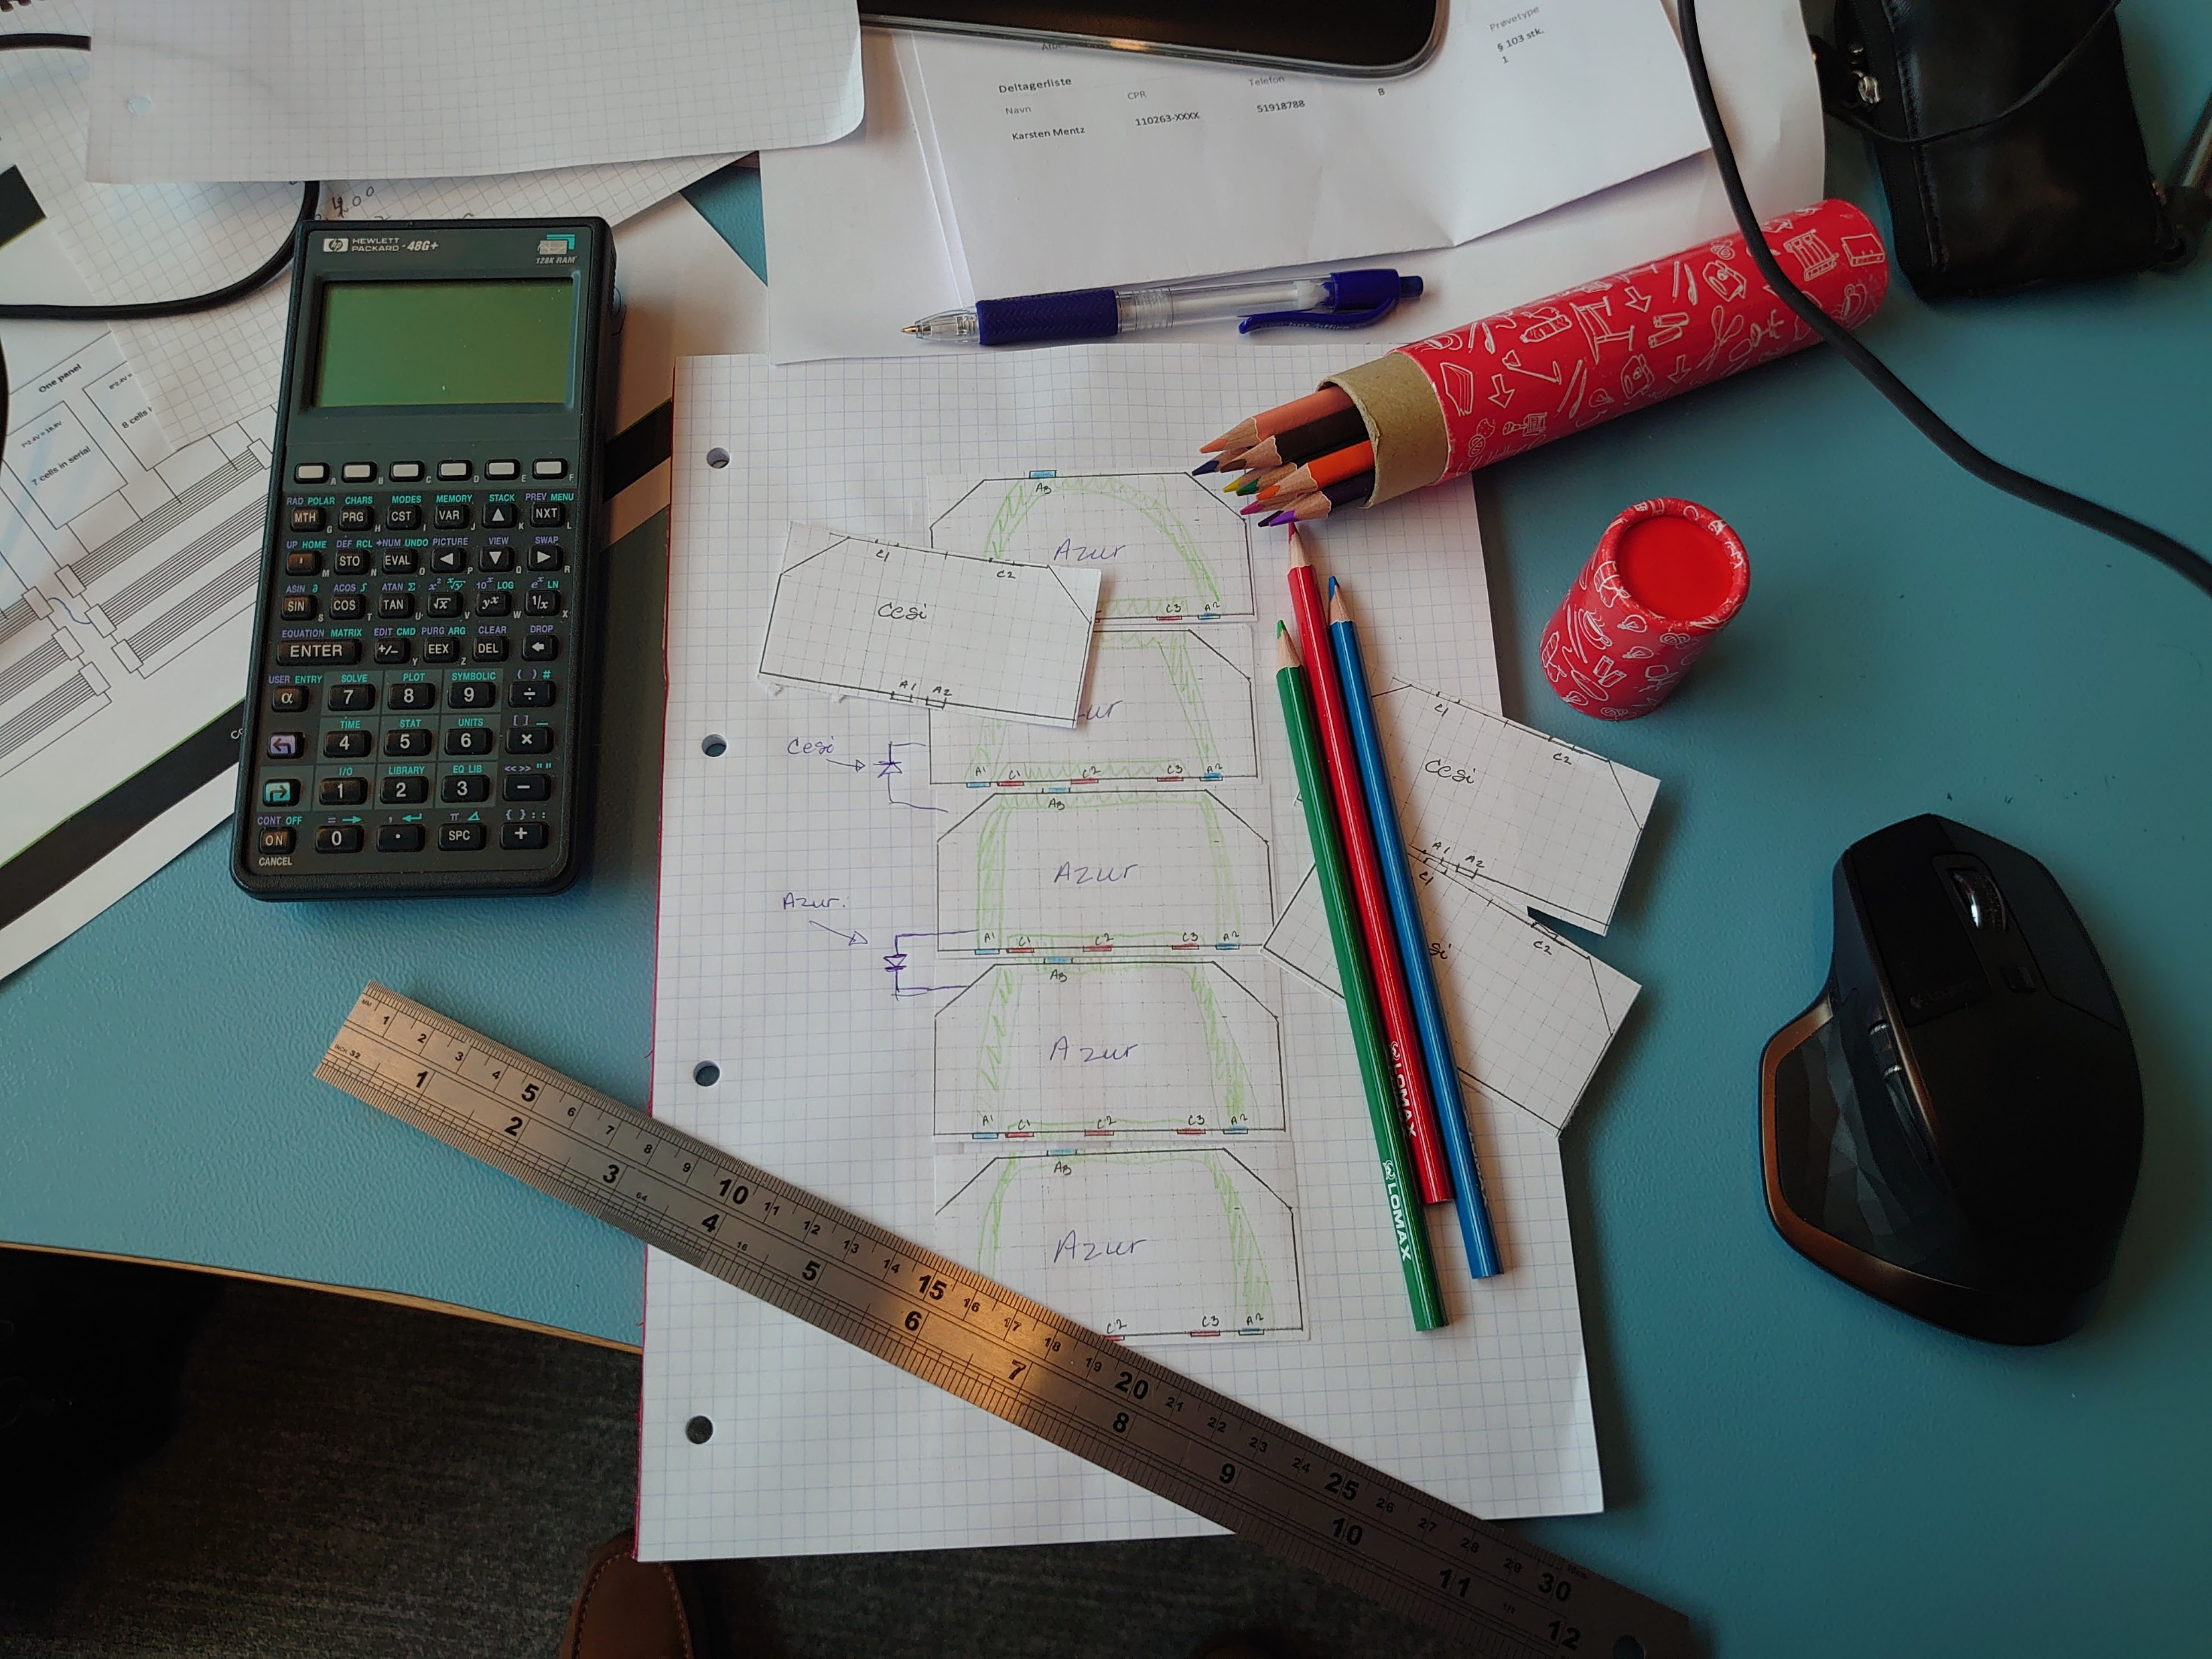
Realy high tech development.

Slide 2
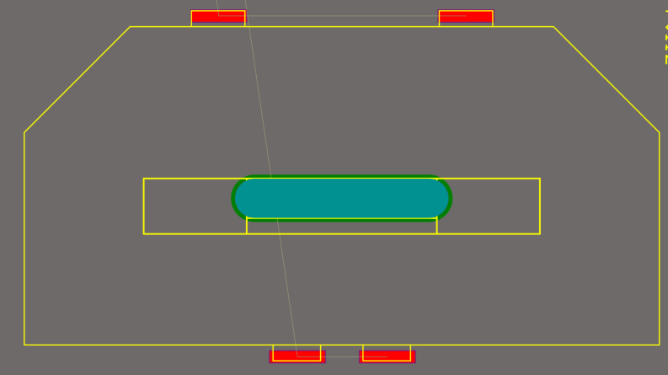
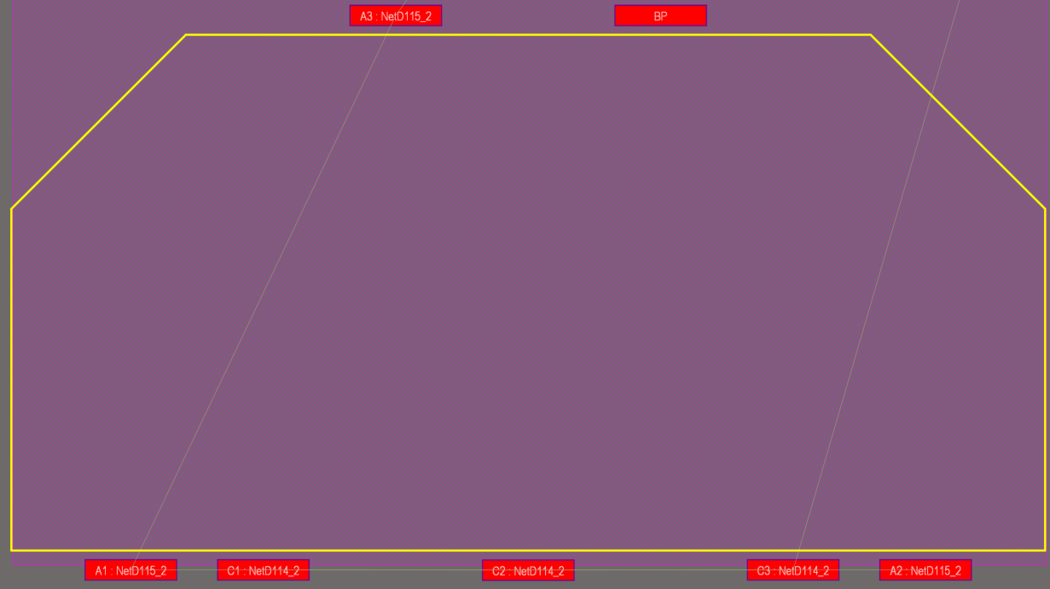
BP tap needs to be unconnected, remove Kova tap on Azur space solar cell..
C1
A3
C2
BP
Azur solar cell
Cesi solar cell
C1
A3
C2
A1
C1
A1
C2
A2
C3
A2
A1
C1
A1
C2
A2
C3
A2

Slide 3
Ennergy Azur space versus Cesi solar cells
Azur
  Nominal 2.4V 500mA @25 degrees Celcisus.
    Gives 1.2W -> 45 cells gives 54W (max) Price 238 Euro
Cesi
  Nominal 2.26V 110mA @25 degrees Celcisus.
    Gives 1.15W -> 45 cells gives 51.8W (max) Price 139 Euro
    Delta (54 – 51.8) = 1.2W or 4.07% Loss Azur versus Cesi.
  The above calculations are NOT taking into account that the efficient is varying by temperature and maybe not is semilar for the two brands.

